Slide 1
Developing Integration Solutions using Microsoft BizTalk Server 2016
Pipelines

Slide 2

Course Outline
Module 1: Introduction to BizTalk Server
Module 2: Schemas
Module 3: Maps
Module 4: Testing and Deploying BizTalk projects
Module 5: Pipelines
Lesson 1: Introduction to Pipelines
Lesson 2: Building a Pipeline
Lesson 3: Custom Pipeline Components
Module 6: Routing
Module 7: Adapters
Module 8: Web Services and WCF
Module 9: Introduction to Orchestrations
Module 10: Applied Orchestration Techniques
Module 11: Business Activity Monitoring
Module 12: Integrating Business Rules
Module 13: Deploying and Managing Applications
Module 14: Windows Azure BizTalk Services

Slide 3
Lesson 1: Introduction to Pipelines
What Is a Pipeline?
Pipeline Scenarios
Receive Pipeline Stages
Send Pipeline Stages
What Are the Default Pipelines?
What Are Custom Pipeline Components?
Types of Pipeline Components

Slide 4
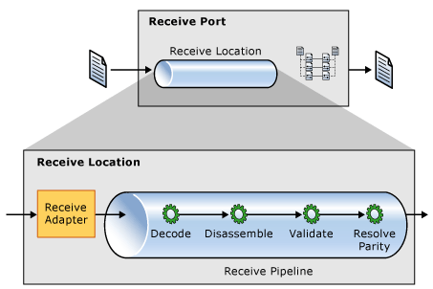


What Is a Pipeline?
Use pipelines to:
Normalize data from various formats to XML
Translate data from XML to various formats
Assemble and disassemble documents
Decode and encode documents
Decrypt and encrypt documents
Assign and verify digital signatures
Receive Pipeline
Message Box
Send Pipeline
Pipeline Components

Slide 5
Pipeline Scenarios
Receive Pipelines
Decrypt inbound messages from trading partners
Split batched messages
Validate messages against known schemas
Verify the sender or parties
Create custom processors to extend built-in functionality
Send Pipelines
Encrypt outbound messages to trading partners
Digitally sign outbound messages
Provide a wrapper for outbound messages
Validate messages against known schemas

Slide 6
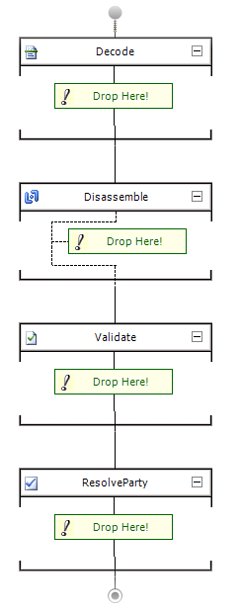
Receive Pipeline Stages
Use to decode or decrypt messages
Use when secure document exchange is required
BizTalk includes a MIME/SMIME Decoder
Use to parse or disassemble components
Use to probe messages and verify context properties
BizTalk Server includes an XML, flat file, and a BTF disassembler
Use to validate the format of an XML message
Use to compare a message to a known schema
Use to verify the sending party for a received message
Use with public certificates to validate sender

Slide 7
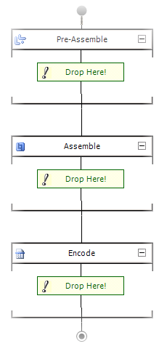
Send Pipeline Stages
Prepare the message to be assembled
Handle the message before assembly, for example while it’s still xml
Use to process a message before it is sent
Use for custom components only
Use to assemble or serialize a message
Use to convert a message from XML to native format
To encode or encrypt messages
Use when secure document exchange is required
BizTalk includes a MIME/SMIME Encoder

Slide 8
Default Pipelines
Pipline | Usage
Pass-Through Receive | Contains no components No decoding, disassembling, or validation required
Pass-Through Send | Contains no components No encoding or assembling required Use for basic message routing
XML Receive | Contains the XML disassembler component Party resolution component for security No decoding or validation stage
XML Send | Contains the XML assembler component Other stages empty by default

Slide 9
Lesson 2: Building a Pipeline
Using the Pipeline Designer
Testing a Pipeline
Demonstration: Creating and Testing a Pipeline

Slide 10
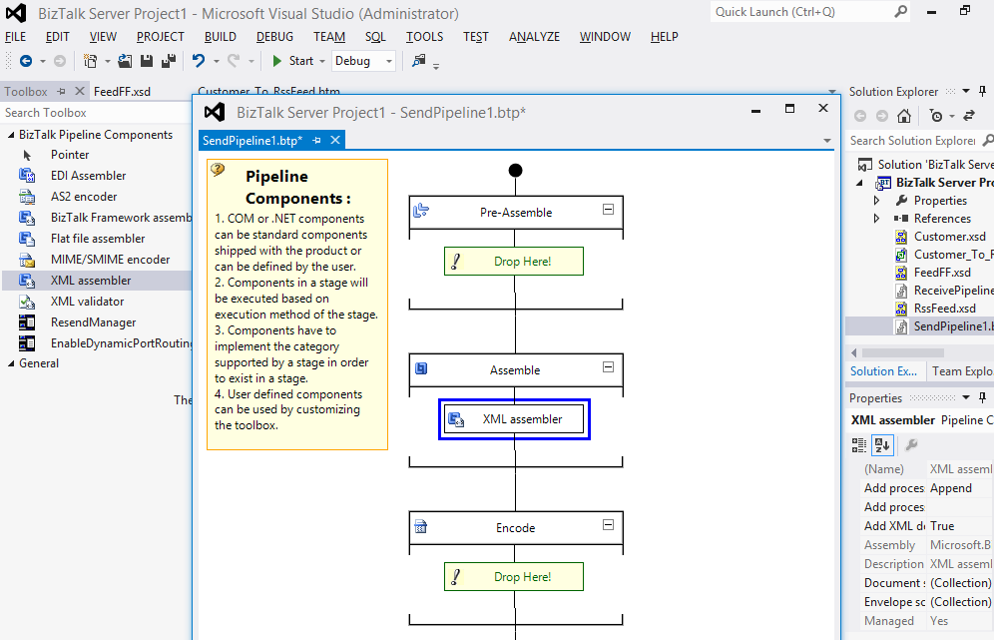
Using the Pipeline Designer
Toolbox
Design Surface

Slide 11
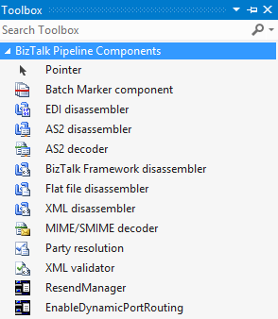
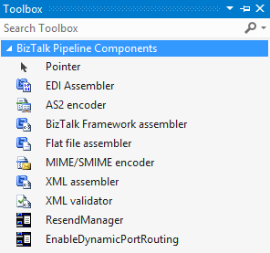
Pipeline Components
Receive Pipeline Components
Send Pipeline Components

Slide 12
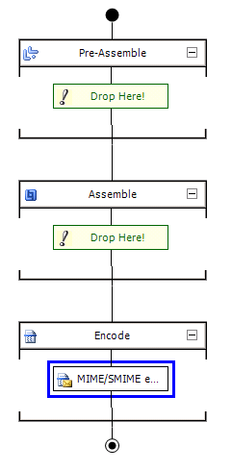

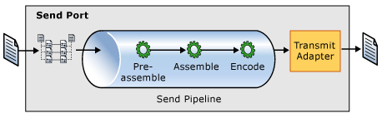

Securing Data by Using a Pipeline
MIME/SMIME Encoder Component
Use for secure exchange of messages
Can use to encode, sign, and encrypt
Supports multi-part messages
MIME/SMIME Encoder

Slide 13

Demonstration: Working with Pipelines
Create and configure a receive pipeline
Notes:
(Slide 13)
Open C:\Demos\Mod5\Start\Mod5Demo1\Mod5Demo1.sln
Show the project, show the schema – flat file schema
Add New Item - Receive Pipeline – Rcv_Customers
Drag and drop a Flat File Disassembler component
Show and explain properties, set Document Schema
Extra1: Create and use a DUMMYFF schema and override the schema property in runtime.
Extra2: Create and use a Send Pipeline that assembles the document back to a flatfile

Slide 14

Pipeline testing tools
Tool | Usages
Pipeline.exe | Produces entire document
FFAsm.exe | Used for flat-file assembler component debugging
FFDasm.exe | Used for flat-file disassembler component debugging
XMLAsm.exe | Used for XML-file assembler component debugging
XMLDasm.exe | Used for XML-file disassembler component debugging
Hint!
All pipeline tools are located in:
[BizTalk install Dir]\SDK\Utilities\PipelineTools

Slide 15
Lesson 3: Custom pipeline components
Custom Pipeline Components
Forward Only Streaming
Demonstration: Forward Only Streaming

Slide 16
Custom Pipeline Components
How?
Three types of components
General
Assembling
Disassembling
Interfaces
IBaseComponent
IComponent
IComponentUI
IPersistPropertyBag
Hint!
Use BizTalk Server Pipeline Component Wizard from Codeplex
http://btsplcw.codeplex.com/

Slide 17
Custom Pipeline Components
Why?
Non-XML validations
Non-supported decryption algorithms
Non-supported signature formats
Custom data conversions
Advanced routing requirements
Specialized processing
Hint!
Avoid loading the message into an XmlDocument!

Slide 18
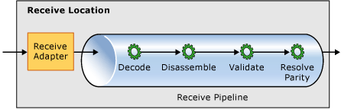

Custom Pipeline Components
public IBaseMessage Execute(IPipelineContext pc, IBaseMessage inmsg)
{
inmsg.Context.Promote("Customer", "http://MyNameSpace", "Vandelay Industries");
inmsg.Context.Write("Customer", "http://MyNameSpace", "Vandelay Industries");
}

Slide 19
Custom Pipeline Components
System.IO.Stream
FileStream
FtpStream
FileConnection
FtpConnection
Microsoft.BizTalk.Streaming.dll
VirtualStream
CEventingReadStream
MarkableForwardOnlyEventingReadStream
m fl…

Slide 20
Demonstration: Custom Pipeline Components
Forward-only Streaming
Notes:
(Slide 20)
Open C:\Demos\Mod5\Start\Demo2\Demo2.sln
Show the FileArchive pipeline component
Talk about the TraceStream and show what the component does.
Add a receive pipeline, Rcv_Archive
Add the component to the toolbox
Drag it to the Decode stage, show properties, configure ArchivePath
Deploy, In Admin Console, Import Bindings, Start.
Run and Test with DebugView open to show difference.
First run with ForwardOnly False, then True

Slide 21
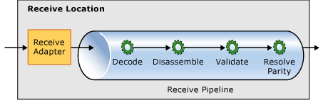
Custom Pipeline Components - Forward-only Streaming
Advanced
1
2
3
4
Execute
Execute
Execute
Execute
5
Read
Read
Read
Read
9
8
7
6

Slide 22
Summary
Pipelines are used to process, and optionally modify, messages as they enter or leave BizTalk Server.
Piplines consists of none to many pipeline components that can be placed in different stages of processing to indicate different functionality.
You have the option of choosing default pipelines or building your own.
You can build custom message processing components to plug into a custom pipeline.

Slide 23
Q & A
Pipelines

Slide 24


Hands-On-Labs
Working with Pipelines
Create a schema using the Flat File Wizard
Create and configure a pipeline to use a flat-file disassembler
Configure the receive pipeline of a BizTalk receive location
Configure the pipeline for recoverable interchange processing

Slide 25

Quiz
What are the names and functions of the default pipelines available in BizTalk Server?
Give an example of why you would create a custom pipeline.
What are pipeline components?

